Slide 2
Biophysics
Bidisha Sinha
Fun read:
Cell biology numbers. http://book.bionumbers.org/; https://bionumbers.hms.harvard.edu/search.aspx (to check BNID)
What is Life?
Em Purcell: Life at low Reynold’s number

Slide 3
Syllabus
Heat as a form of energy: Concept of free energy; free energy transduction; order/disorder in biology; forces and energies
Molecular interactions: Physical basis and implications in biology
Dimensions and Units: Dimensional analysis; biomolecules dimensions, arrangements, internal energies
Special properties of water: Importance in biology
Overview of structures inside cells: Dimensions, crowding, basic functioning principles, timescales of cellular processes; energies/forces inside live cells. Modes of information transfer;
Distributions in nature: Origin, implications

Slide 4
Biophysics
Using Physics to understand Biology
Biology?
Life?
Physical Laws in Biological systems??
Physical Laws in other systems??
WHERE DO WE START FROM??????
...Classwork 1
http://whatislife.stanford.edu/LoCo_files/What-is-Life.pdf

Slide 5
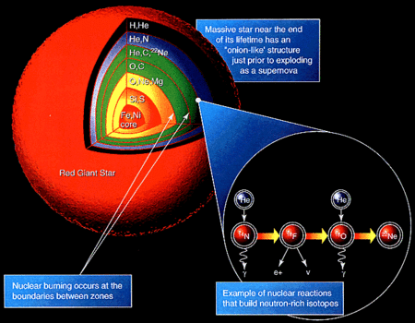
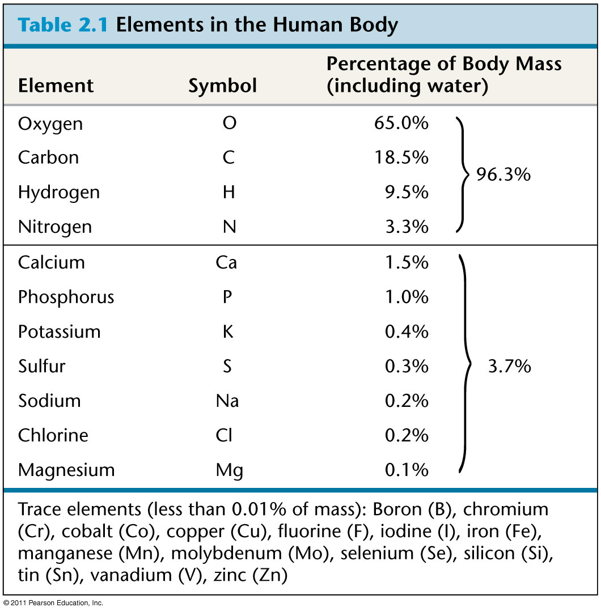
What makes us??
Where was that made?

Slide 6
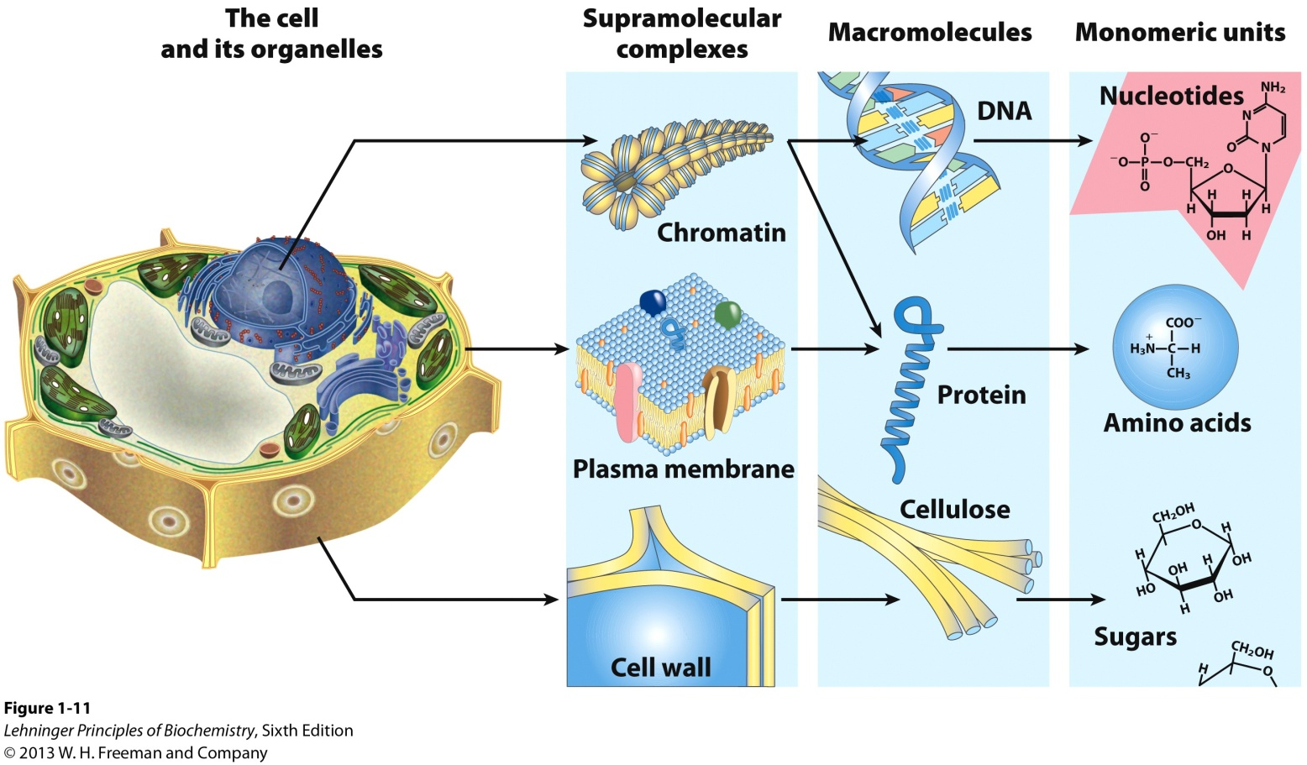
What makes us??

Slide 7
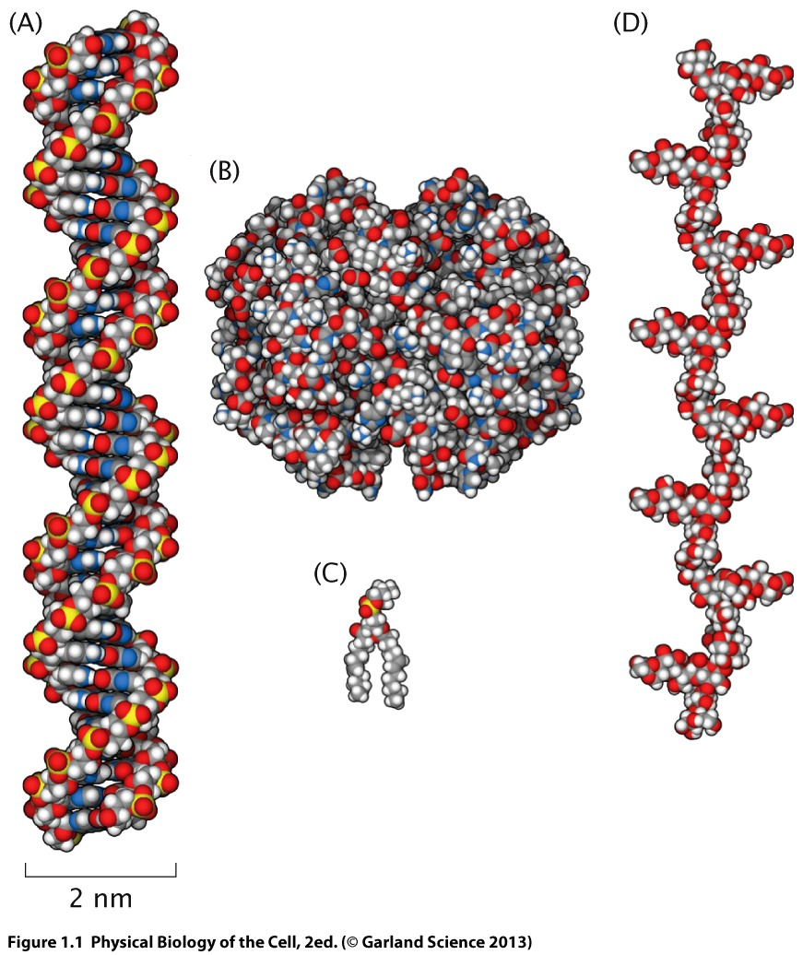
What makes us??

Slide 8
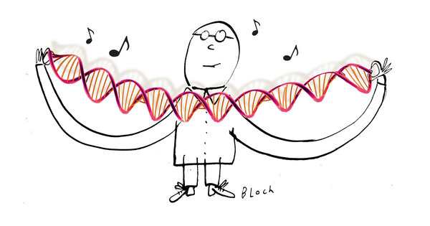
Synthetic life
Peering Over the Fortress That Is the Mighty Cell
June 2010
http://www.nytimes.com/2010/06/01/science/01angi.html?pagewanted=all&_r=0
https://www.ted.com/talks/craig_venter_unveils_synthetic_life
When the Venter team inserted the synthetic version of the Mycoplasma mycoides genome into the cellular housing of the Mycoplasma capricolum bacterium, the newcomer took full advantage of the resident cytoplasmic wares.
A bag of chemicals?
What’s so special?
How do we understand/explain the net behaviour of this bag

Slide 9
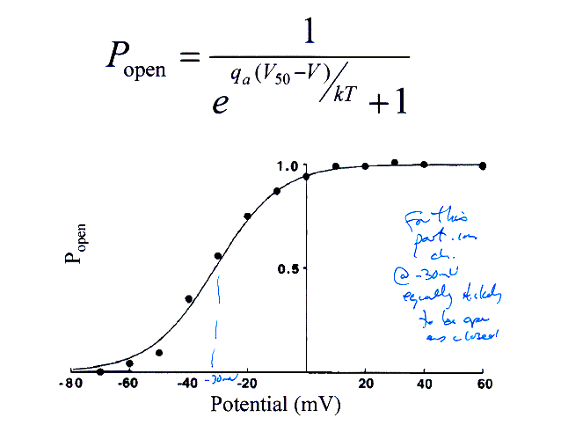
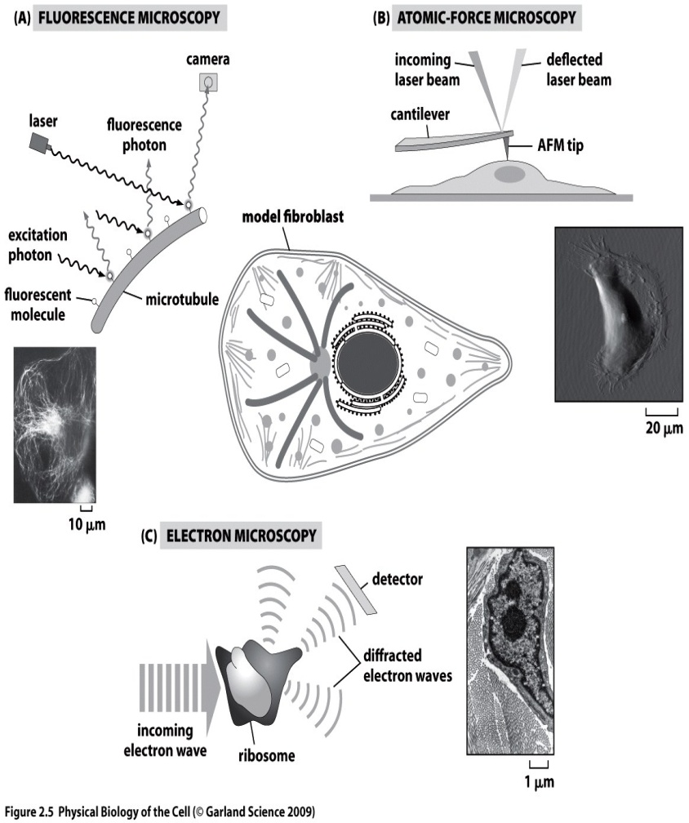
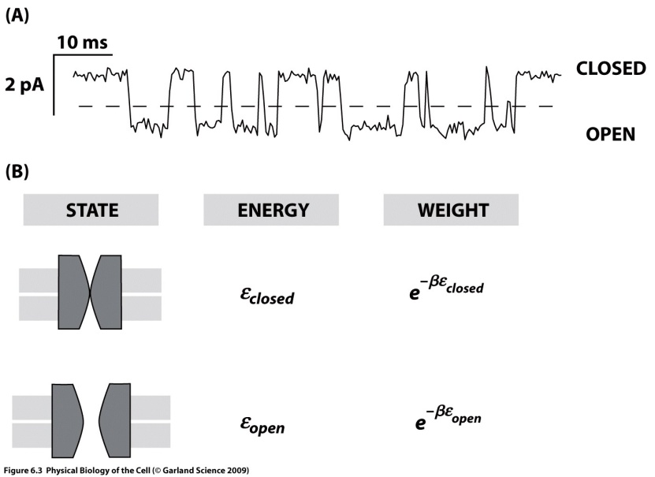
Biophysics
Modelling:
Measuring: New methods to see/measure better
Molecules
Structures
Cells
Populations
Networks
Looks different than F=ma

Slide 10
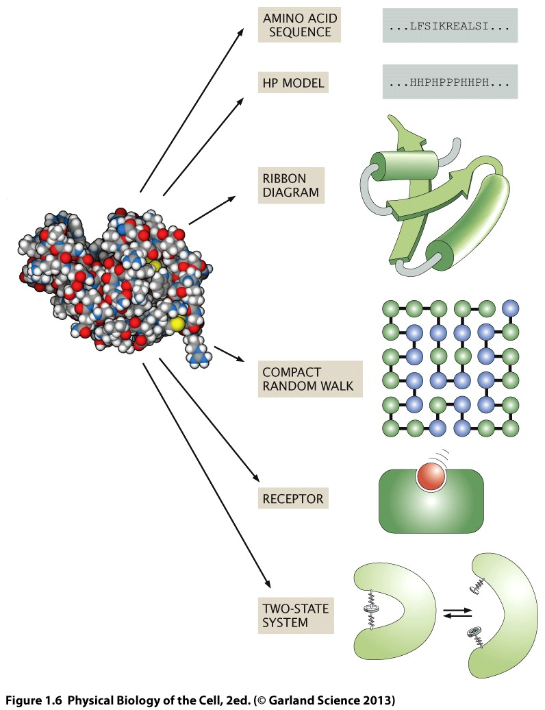
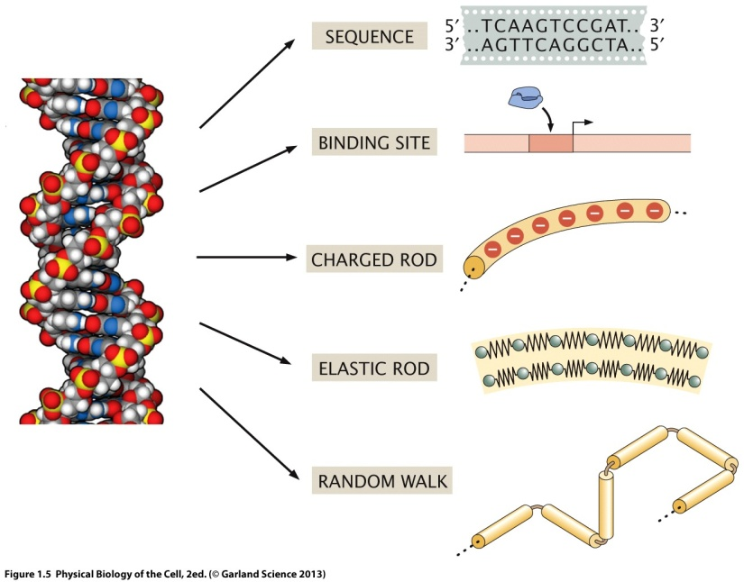
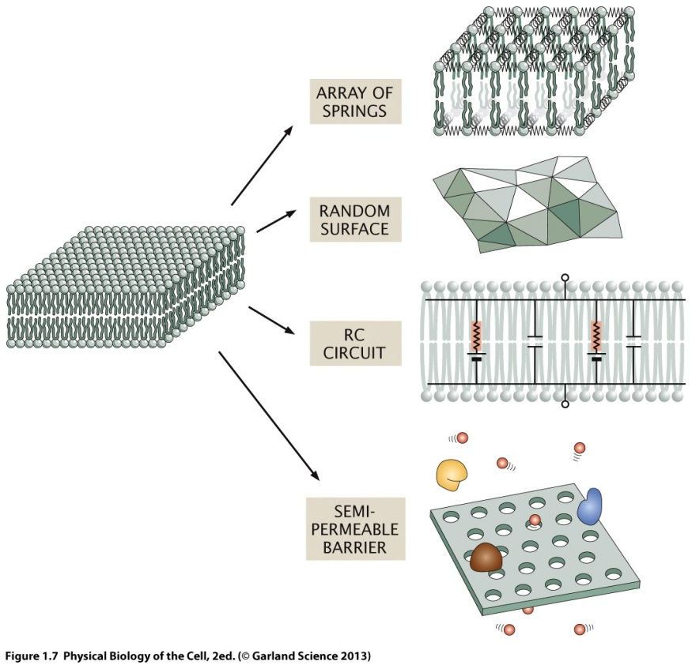
Take a macromolecule
..or a patch of membrane

Slide 11
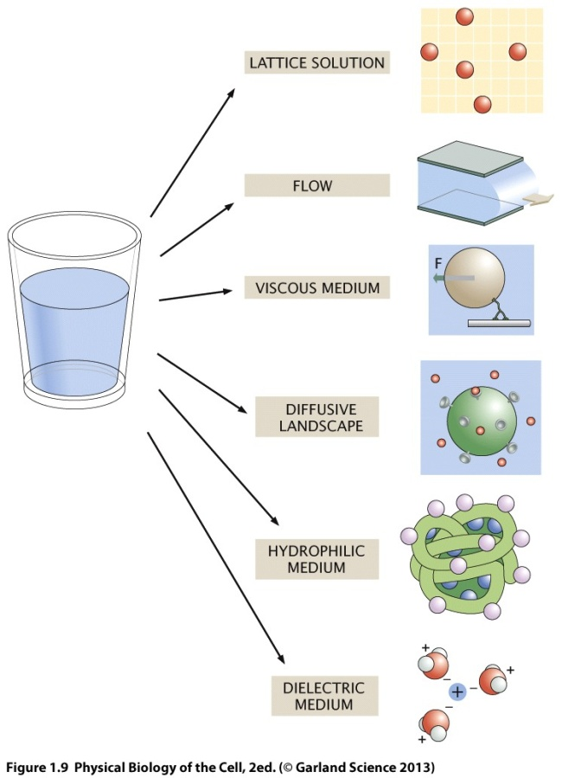
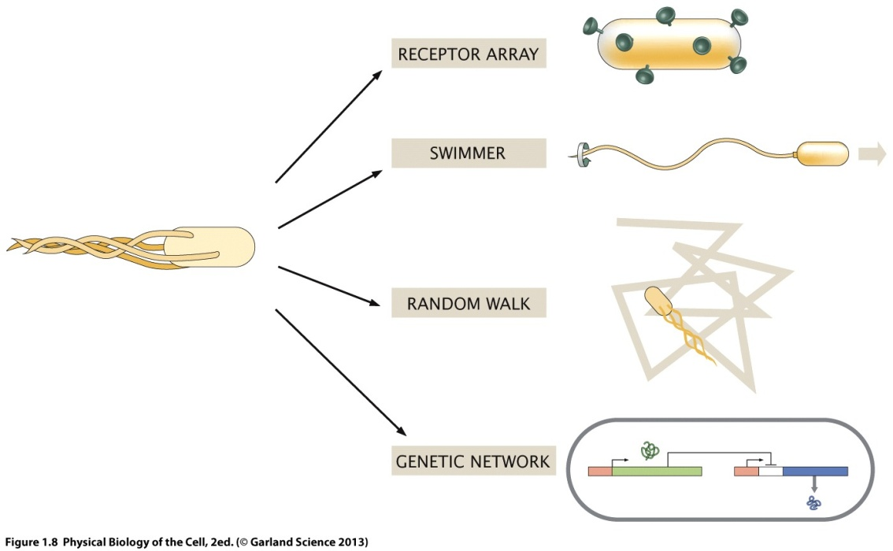
Take a cell
Solution

Slide 12
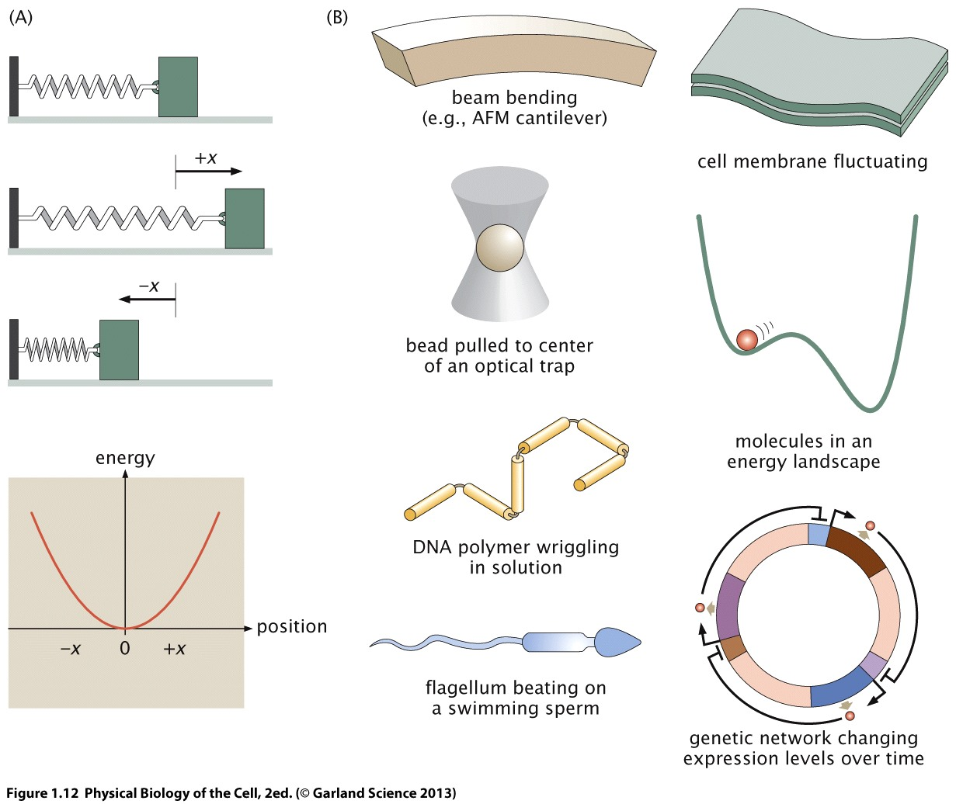
The Spring in biology

Slide 13
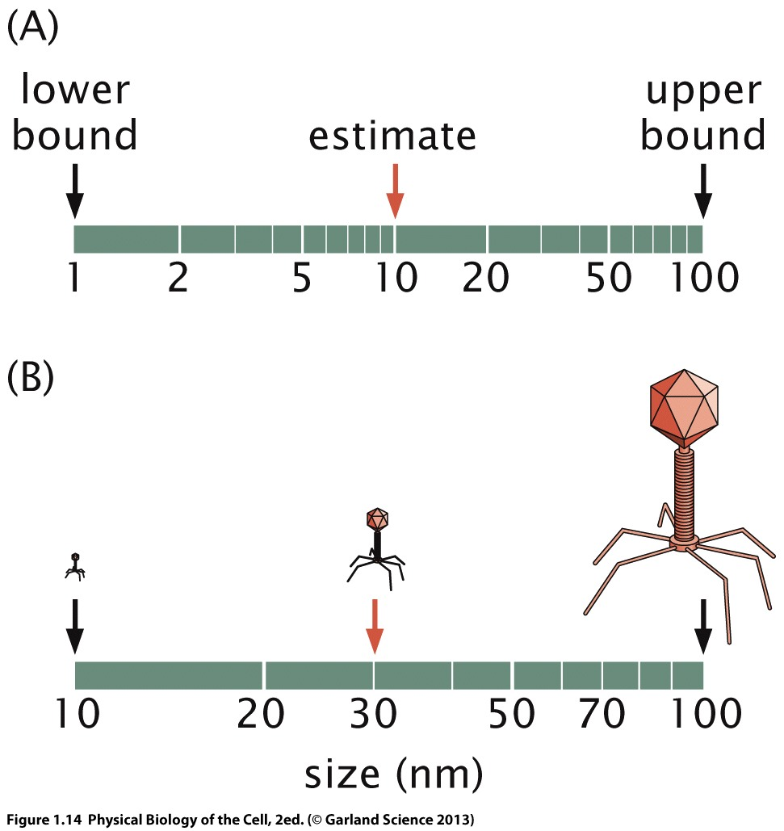
The role of estimates

Slide 14
Different sizes
Physical Biology of the Cell

Slide 15
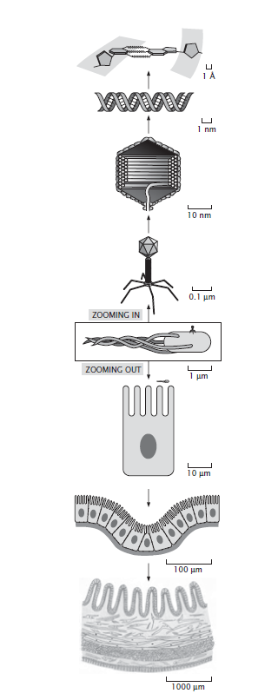
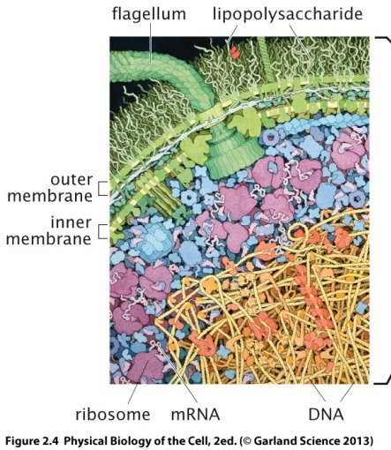
Importance of Making ESTIMATES

Slide 16
A. Concentration, pH, interparticle distances
Most abundant molecule in us?
Approximate concentration of water (Molarity)?
Distance between water molecules?

Slide 17
A. Concentration, pH, interparticle distances
Most abundant molecule in us?
Approximate concentration of water (Molarity)?
Distance between water molecules?
Distance between molecules that are present at x mM concentration?
In general – interparticle distance vs concentration? (plot with log scale)
pH? pH and distance with H⁺ ions? Highest pH structure in cell? Size?
No. of H⁺ ions?

Slide 18
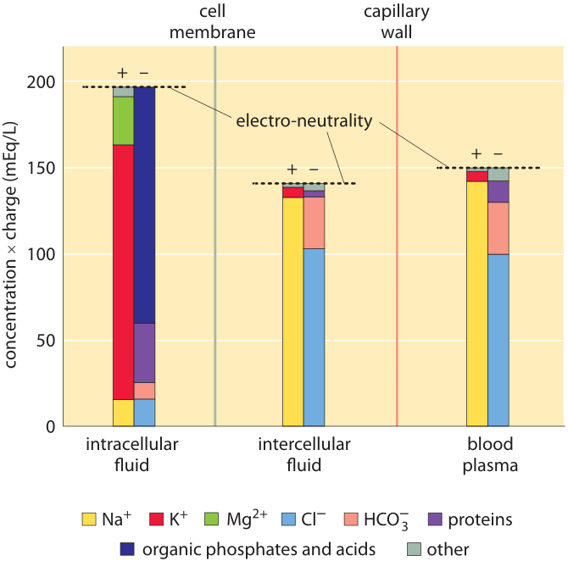
Even though it is not evident from the figure, the total free solute concentrations (sum of concentrations of both positive and negative components not taking into account their charge) are the same in the intracellular and intercellular fluid. This reflects that the two compartments are in osmotic balance. (Adapted from O. Andersen, “Cellular electrolyte metabolism” in Encyclopedia of Metalloproteins, Springer, pp. 580-587, 2013, BNID 110754.

Slide 19
1 molecule in 1 E coli = ? Concentration?

Slide 20
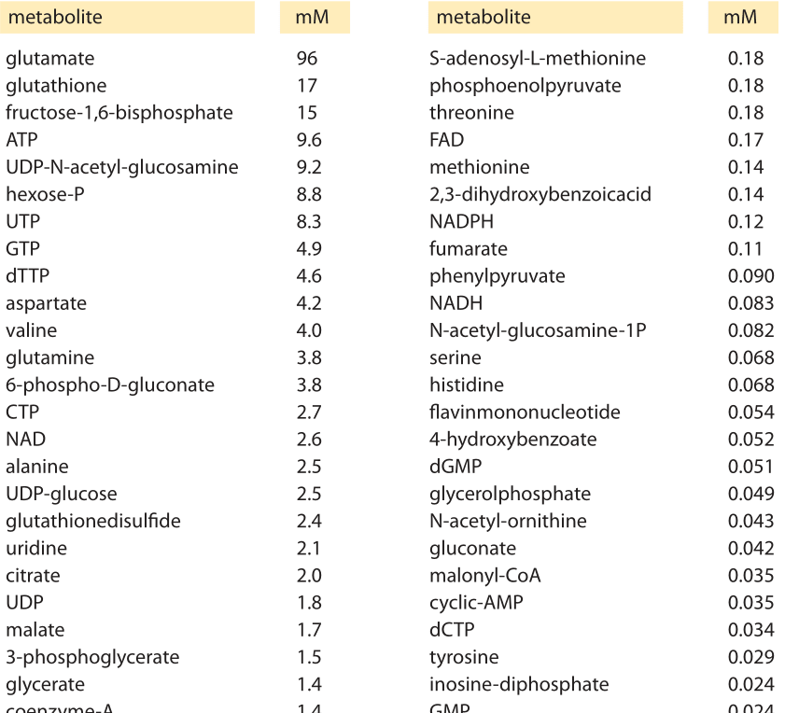
Lac repressor tetramers per cell
Value | 5 tetramer molecules
Gilbert W, Muller-Hill B. 1966. Isolation of the lac repressor. Proc. Natl. Acad. Sci. USA 56:1891–98PubMed ID16591435

Slide 21
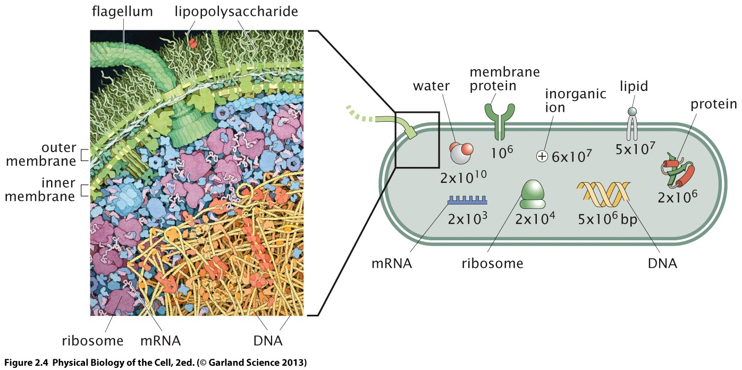

Slide 22
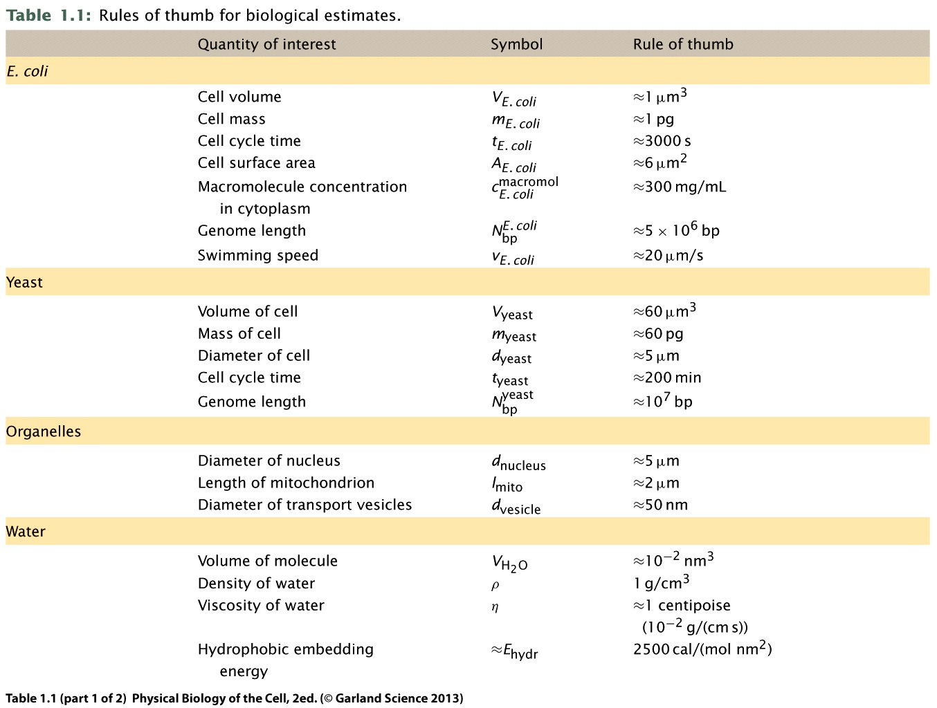

Slide 23
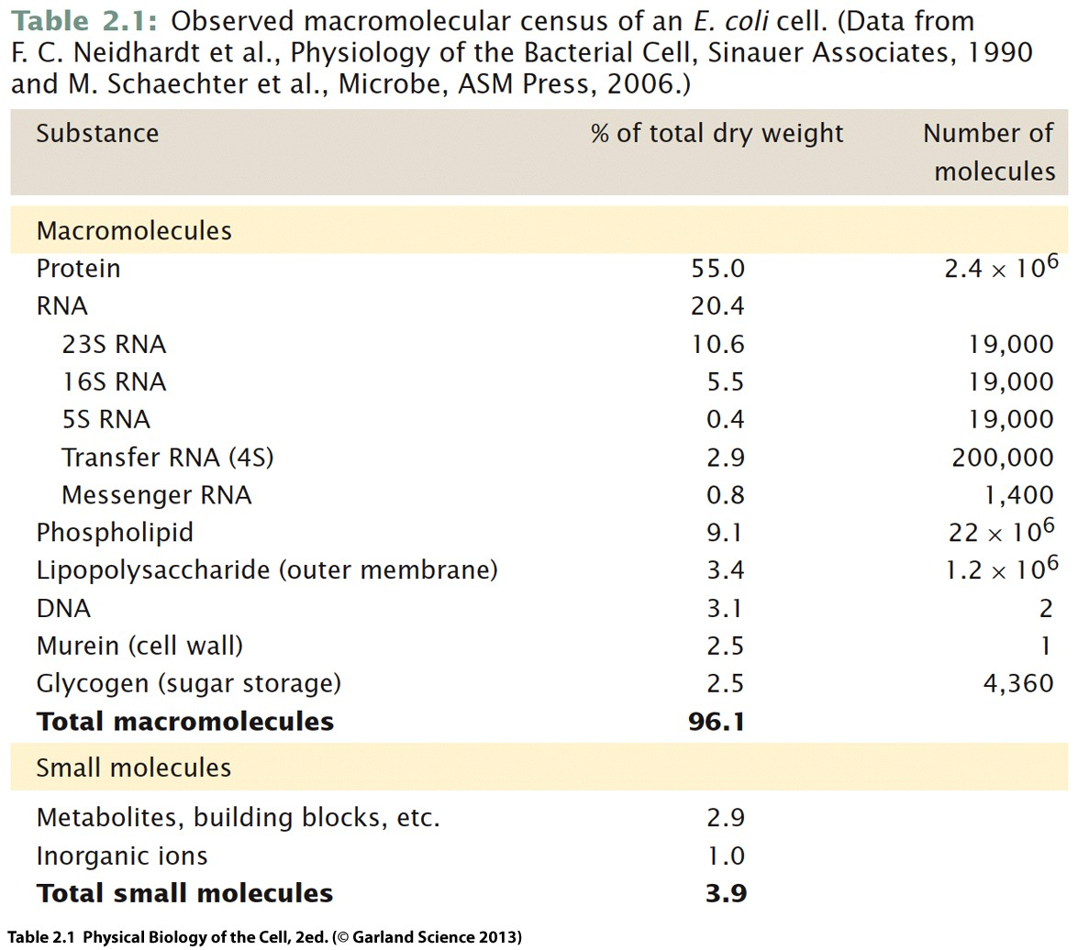

Slide 24
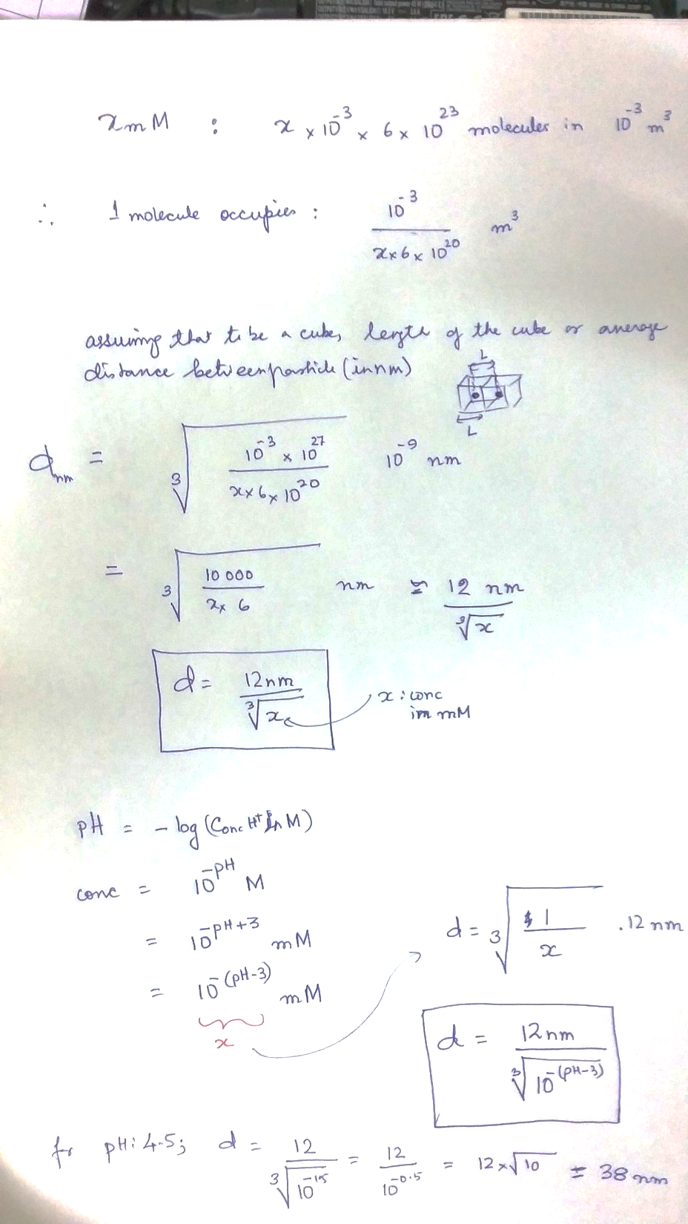

Slide 25
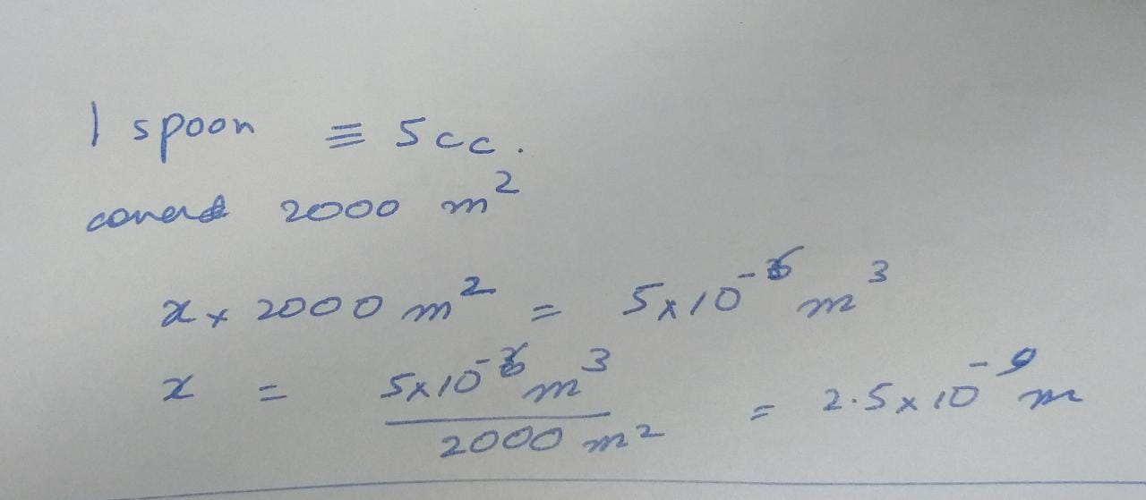
More estimates
Franklins’s oil experiment: 1 spoon: 5 cc covered 2000 m² of pond water. Size of an oil molecule?

Slide 26

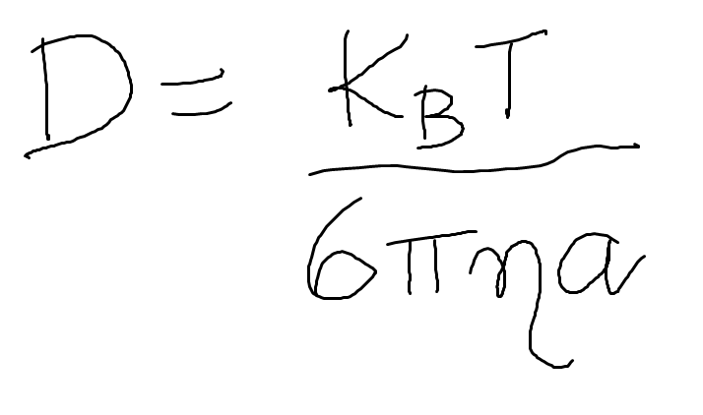
Fluctuations are incessant – cannot be ignored
…….but size matters
= (200/a_{nm}) μm²/sec
Einstien, Stokes

